Slide 1
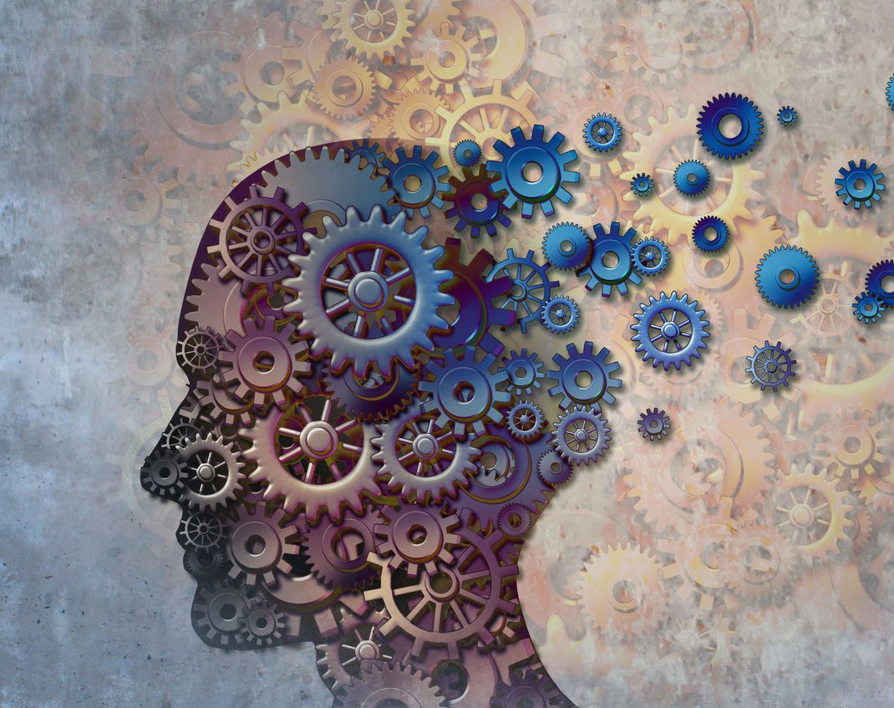

Predicting Alzheimer’s Disease Using Brain MRI
Feras Altwal
Capstone Project
DSIR-824

Slide 2
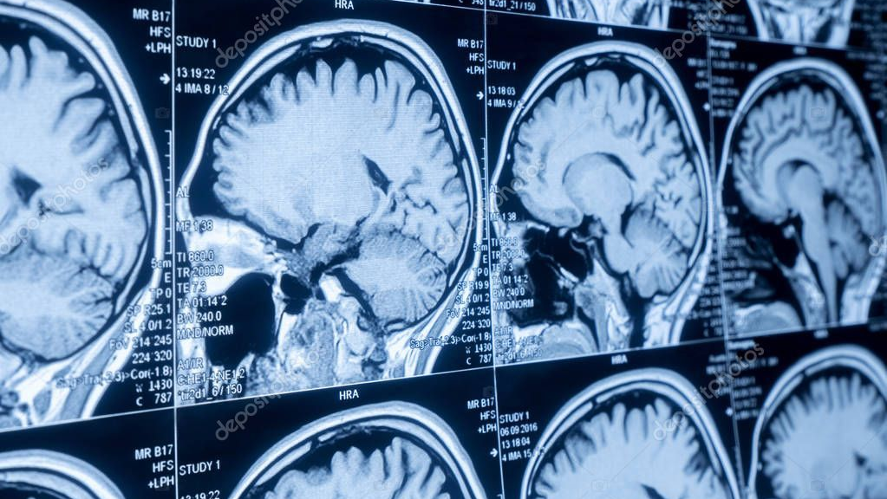
Problem Statement
Can we detect Alzheimer’s disease using brain MRI?

Slide 3
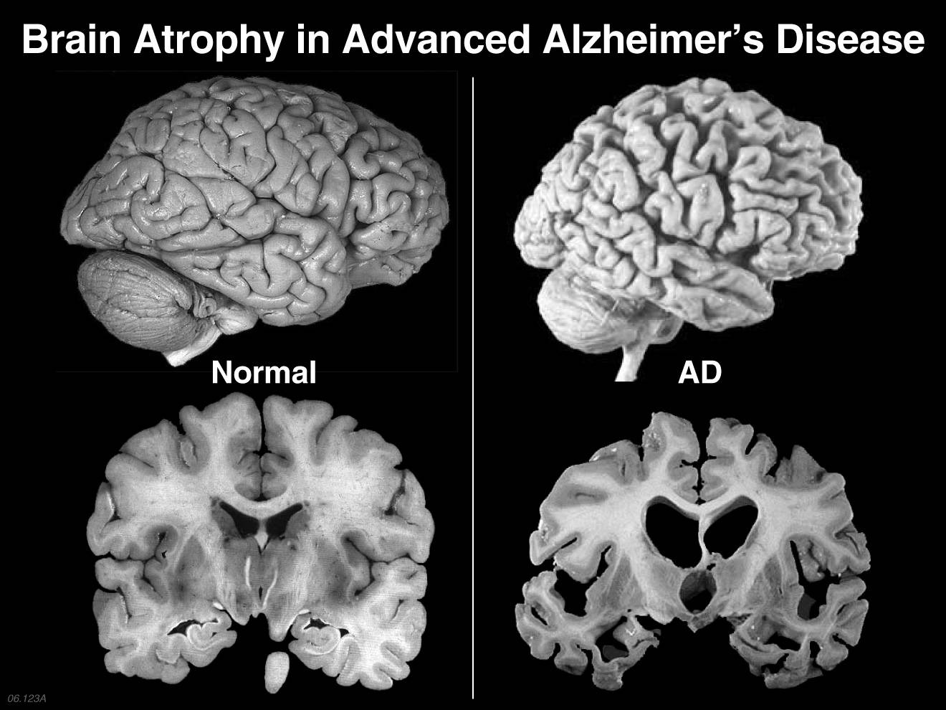
Alzheimer’s Disease (AD)
Progressive neurodegenerative disease
Affects memory, language, reasoning, social behavior
Affects 44 million around the world, 5.5 million in the US

Slide 4
Project Pipeline
Data collection
Image
pre-processing
Data visualization
Modeling
Interactive Model

Slide 5
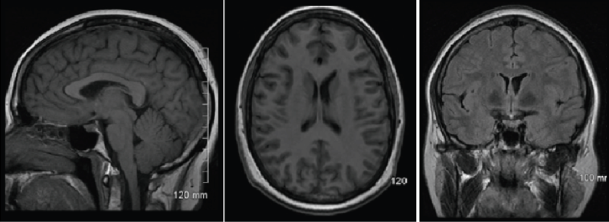
ADNI Dataset
Alzheimer's Disease Neuroimaging Initiative (ADNI)
Well-maintained collections of brain images (MRI, PET scans)

Slide 6
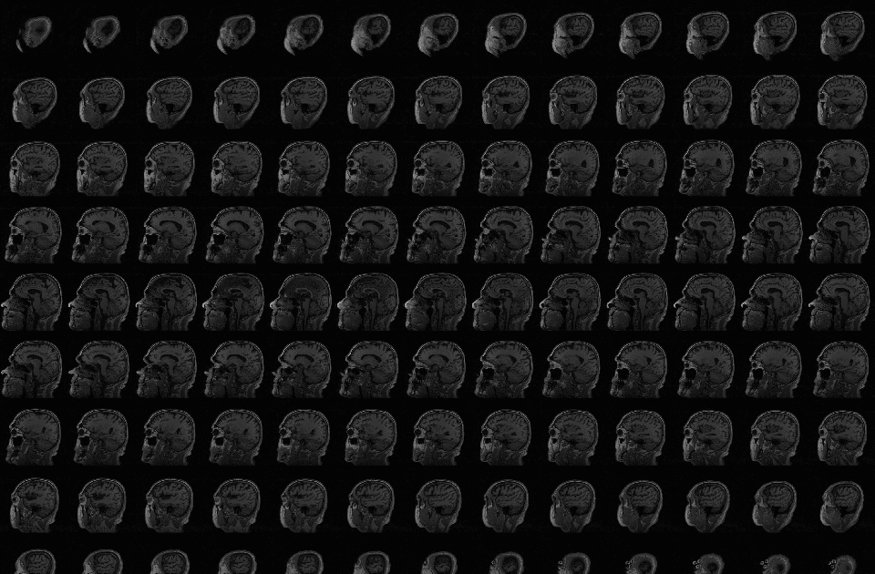
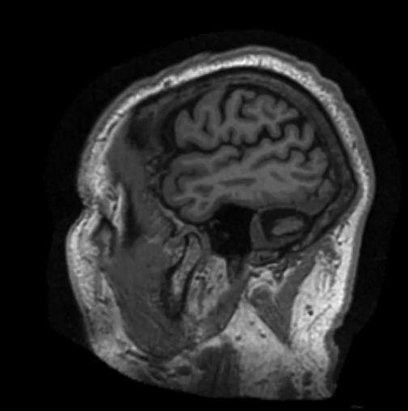
Dataset
T1-MRI images provided as NIFTI files
NIFTI contains 160-170 images/ patient
Patients:
AD: 117 subjects (~10K images)
CN: 137 subjects (~12K images)

Slide 7
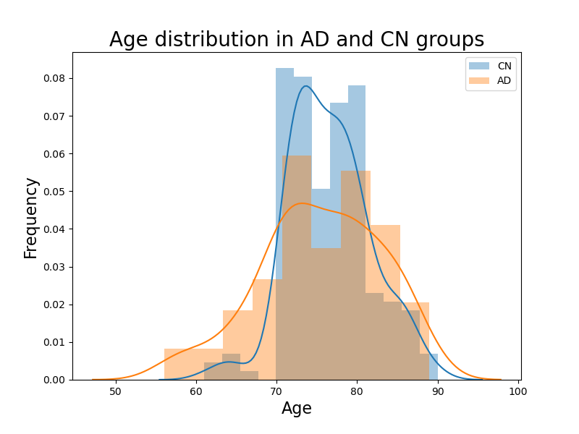
EDA

Slide 8
Image Processing
image Extraction
Skull stripping
resizing
Grayscale

Slide 9
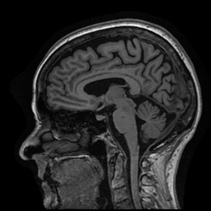
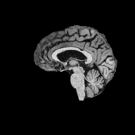
Image Processing
Skull stripping using a modified deepbrain library

Slide 10
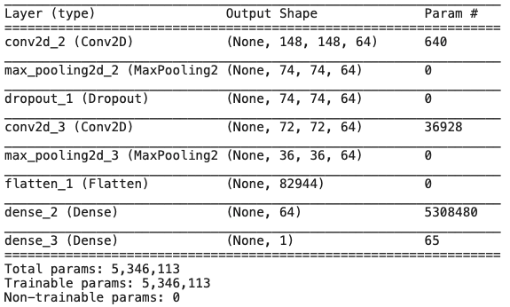
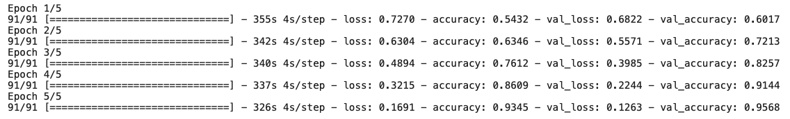
Modeling
Baseline model = ~50% accuracy
Simple CNN model

Slide 11
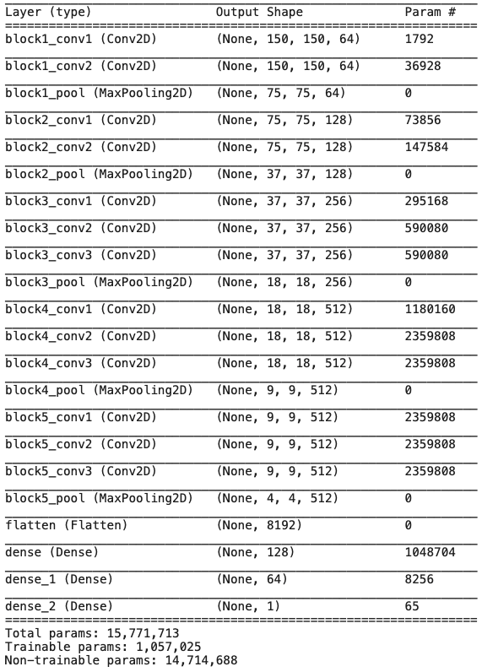
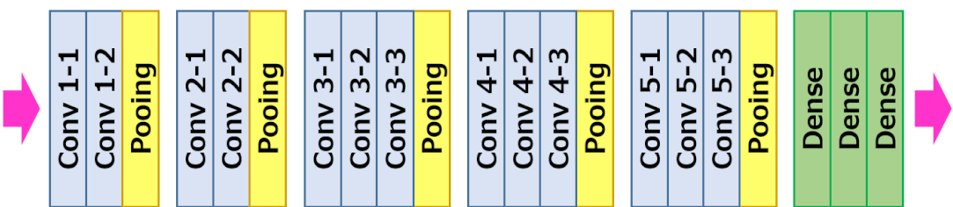
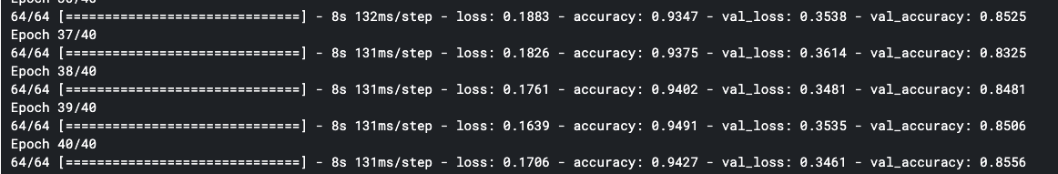
Modeling
TL model: VGG16

Slide 12
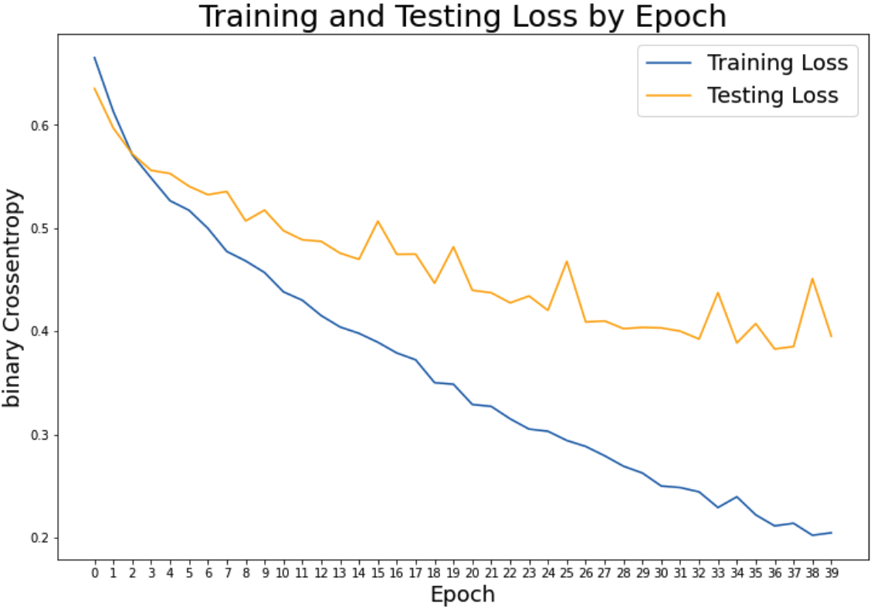
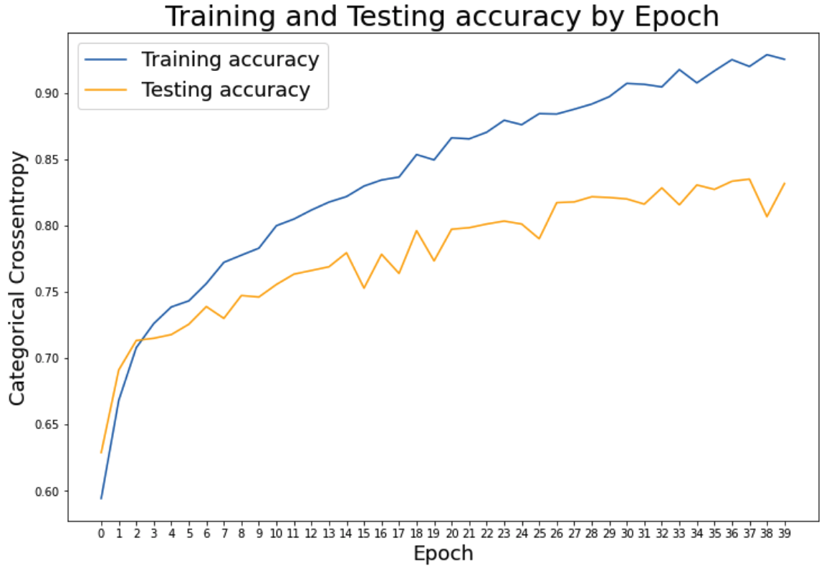
VGG16 model metrics
Loss by epoch
Accuracy by epoch

Slide 13

Interactive Model
AD Detector

Slide 14
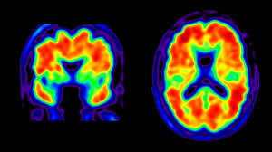
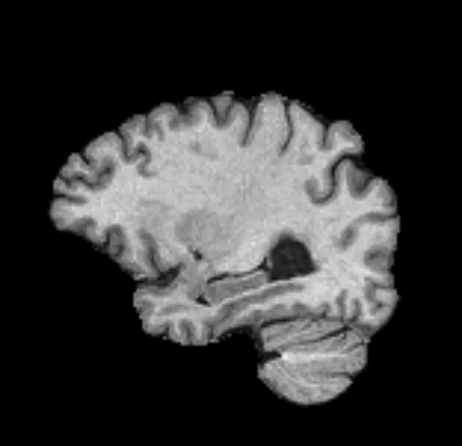
Conclusion & Future Directions
VGG16 model performed the best
More modalities (coronal and axial MRI, PET scans)
More image pre-processing
CONV3D
Try other TL models
Classify pre-stages of AD (MCI)

Slide 15

Questions?

